Slide 1
Project Management assıstant
Project Members:
HAKAN İREN
SELÇUK ATAGÜN
Advisor: PROF. DR. ERDOĞAN DOĞDU

Slide 2
Contents
Company Information
Problem
Analysis
Solution
Results and Conclusion
References
Demo

Slide 3
Company Information
Turk Telekom, Turkey’s leading communication and convergence technologies company, successfully continues to sustain its mission of providing Turkey with the latest communication Technologies.
Turk Telekom provides IPTV, Satellite TV, Web TV, Mobile TV, Smart TV services. At the same time, it has 100% of online education softwares, call center, wholesale data and capacity service provider Türk Telekom International and its affiliates.

Slide 4
Problem
In many companies, projects are still being offered via paper and are progressing manually. This situation causes too much paper waste and slowing down of jobs.
Many of the project management systems prevent the end-user from operating comfortably due to the complexity of the interface and the difficulty of following up on increasing projects.

Slide 5
Problem
None of the project management systems, there is no factor that enables projects to be completed or accelerated.
It is very difficult to add interpersonal assignment and new project requirements to the system in most of the project management systems.

Slide 6

Analysis
Speed Problem
- The aim is to accelerate ongoing work on paper by transferring it to digital media. Making it easily accessible.

Slide 7
Analysis
Complexity and Assign Problem
- Project management systems should be easy to use and functional. Users should increase their activities on projects. User must assign between contacts. The aim is to make it easy to use and to get maximum speed. In addition, new features can be added.

Slide 8
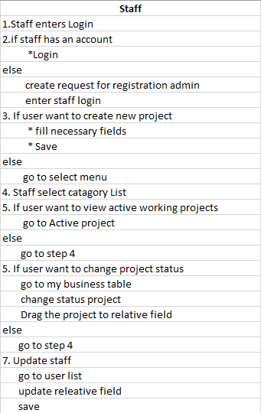
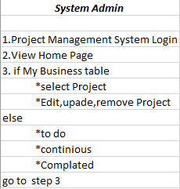
Solution

Slide 9
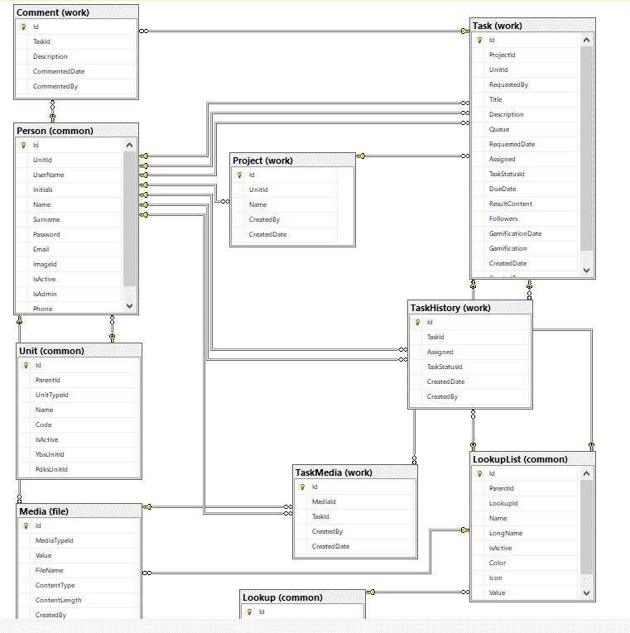
Solution

Slide 10
Results and Conclusions
As a result, this project management assistant will be preferred by the companies regarding rewarding system that will encourage the users, ease of use, and assign among people.
The project is especially wanted to be used by Turk Telekom which we are still working on and will be used more actively and further used.
Advantages,
Reward system
Easy interface
Assigning between contacts
Easy project tracking and reporting.

Slide 11
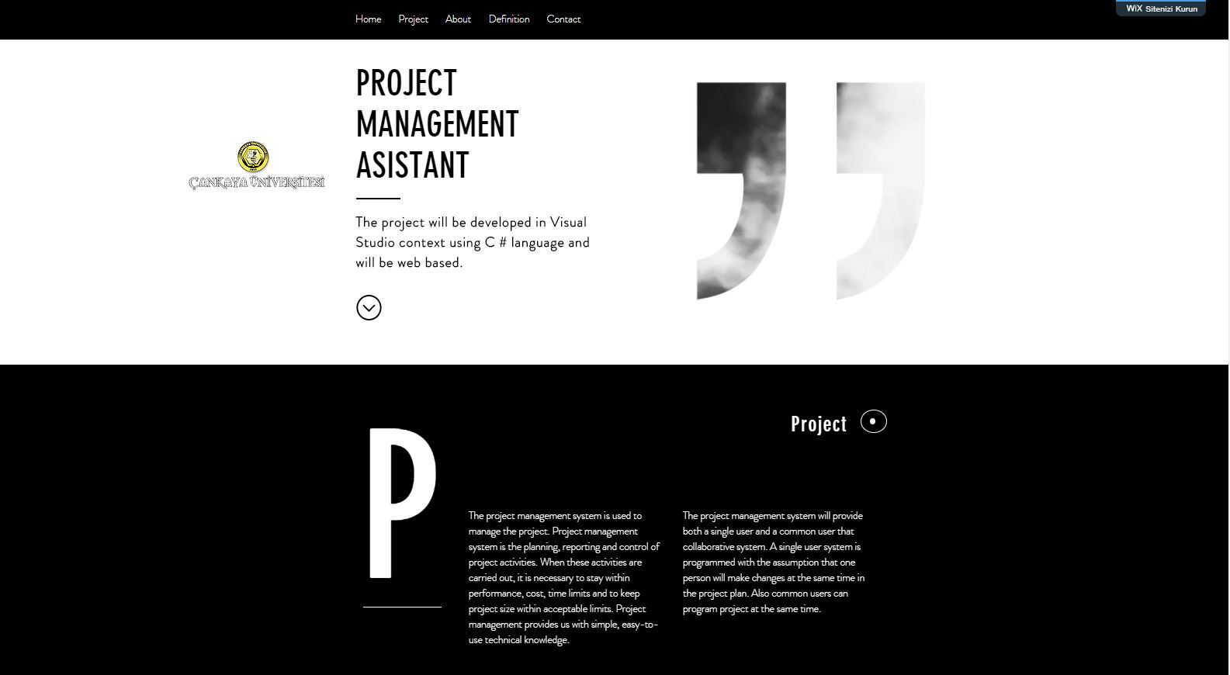
Project Website
https://projectmanager408.wixsite.com/pma408

Slide 12
References
1.IEEE SDD 1016 - IEEE Recommended Practice for Software Design Descriptions
2.Somerville, I., 2004. “Software Engineering”, USA: ADDISON-WESLEY, seventh edition.
3.Pressman, Roger S., Software Engineering, 4th edition, McGraw-Hill, 1997
For Project Management SDD Version1.0
4.Fairley, R. E.,Workbreakdown Structure, Software Engineering Project Management, IEEE CS Press, 1997

Slide 13
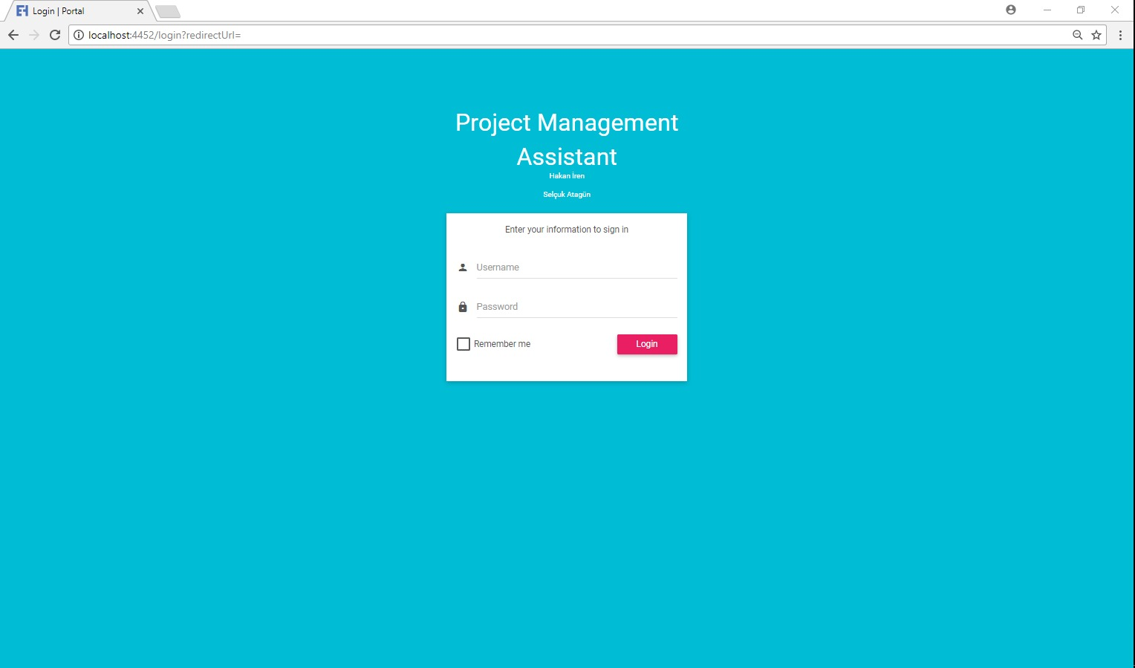
Login Page

Slide 14
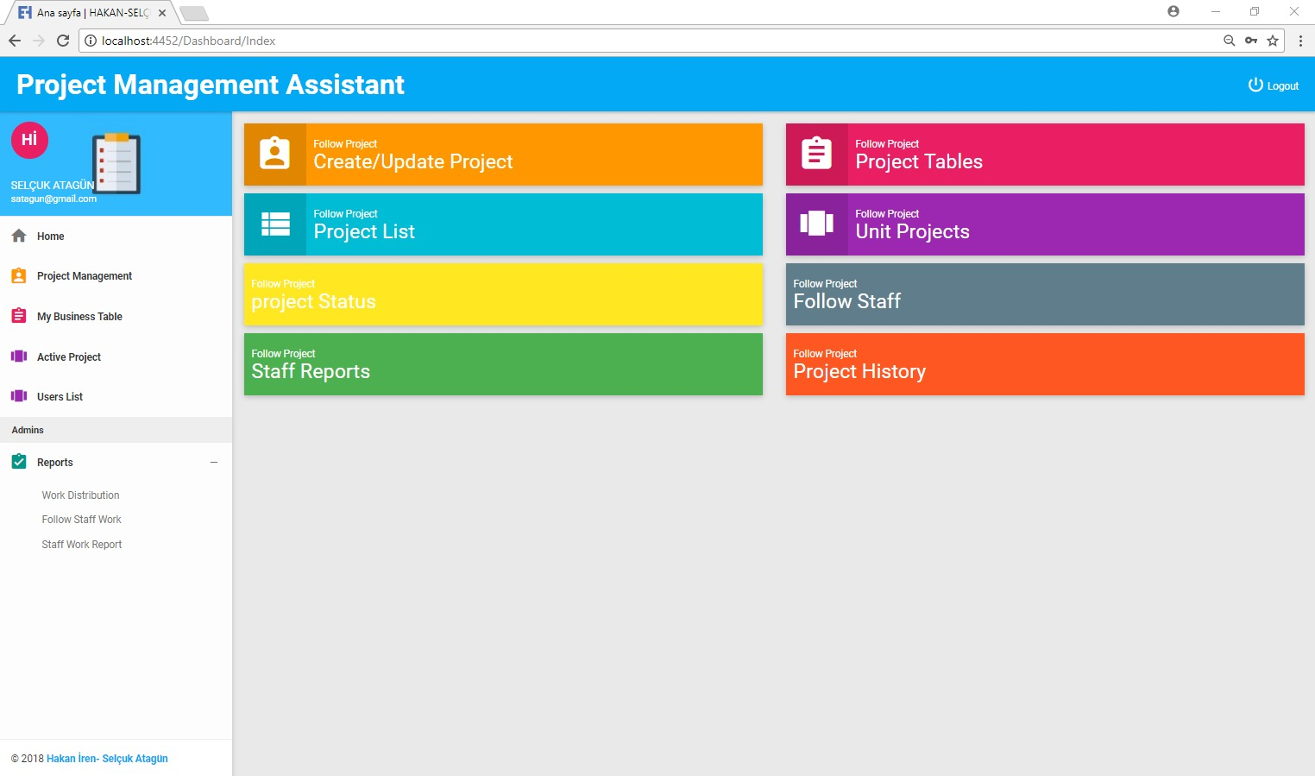
Home Page

Slide 15
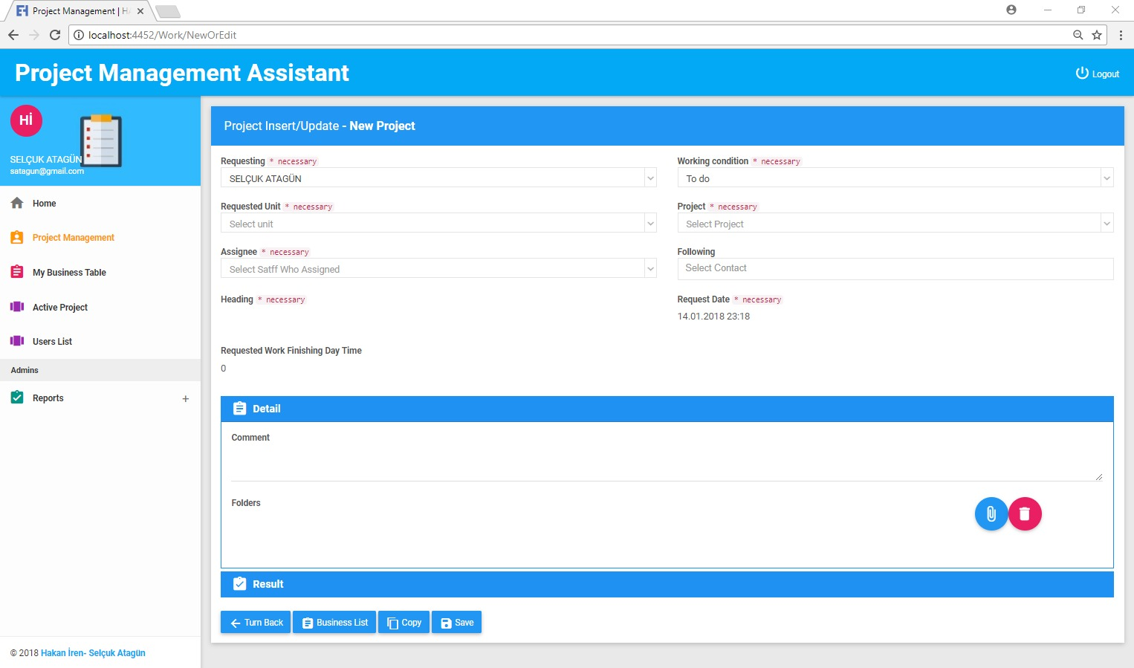
Project Management

Slide 16
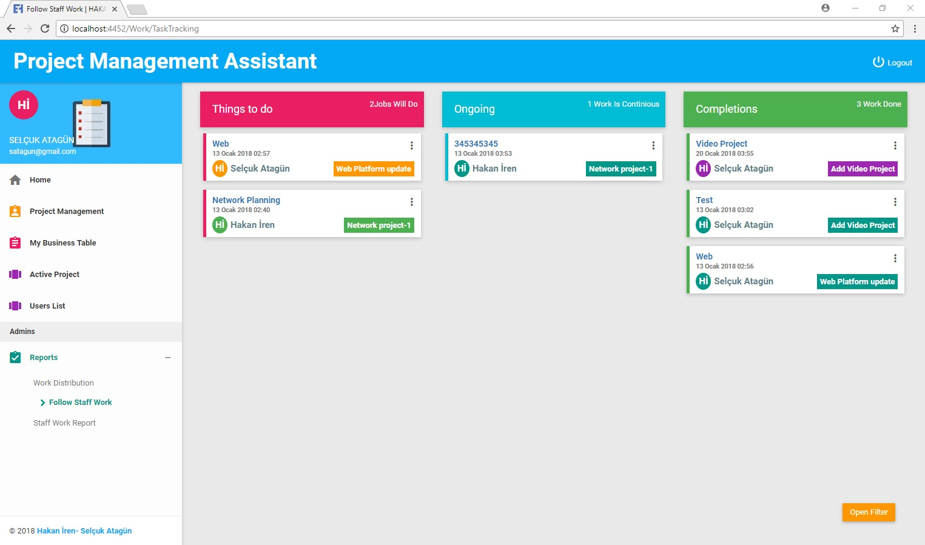
My Business Table

Slide 17
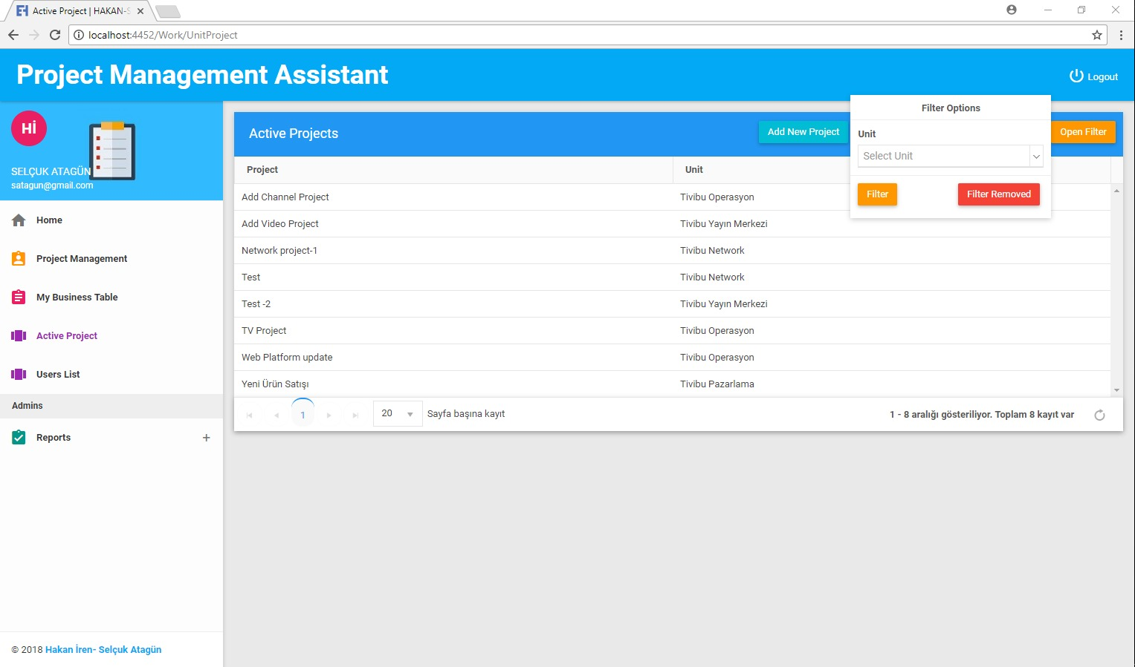
Active Project Table

Slide 18
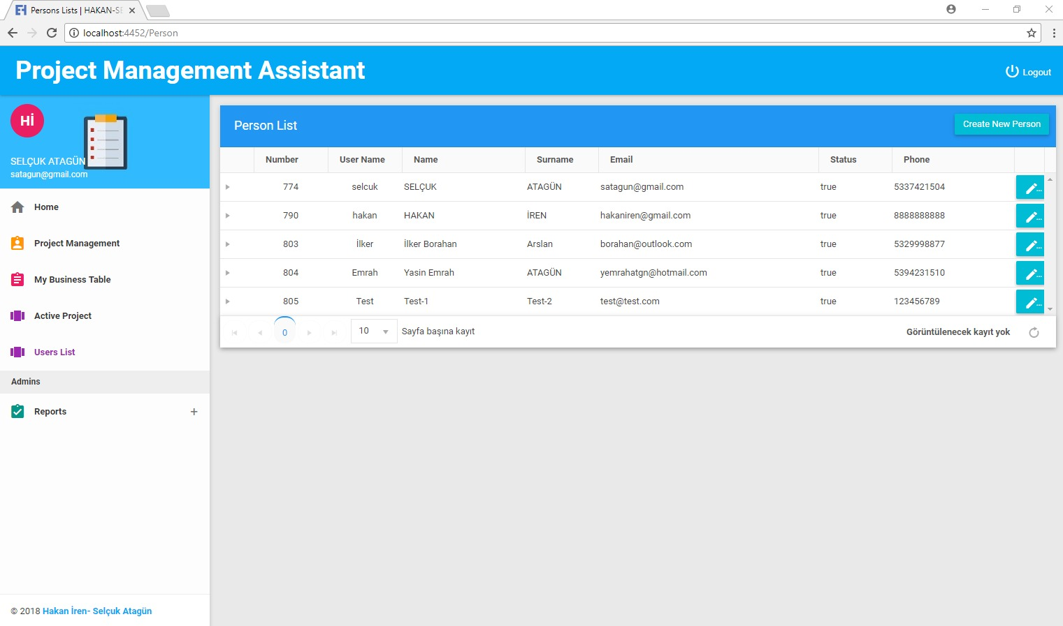
User List

Slide 19
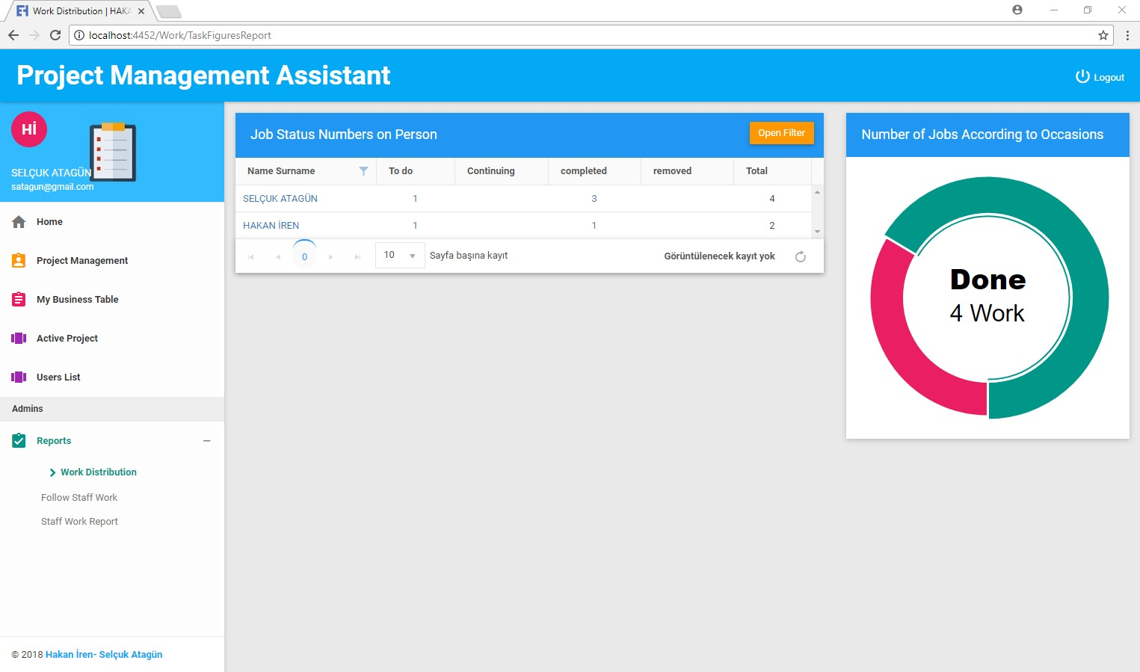
Work Distribution Page

Slide 20
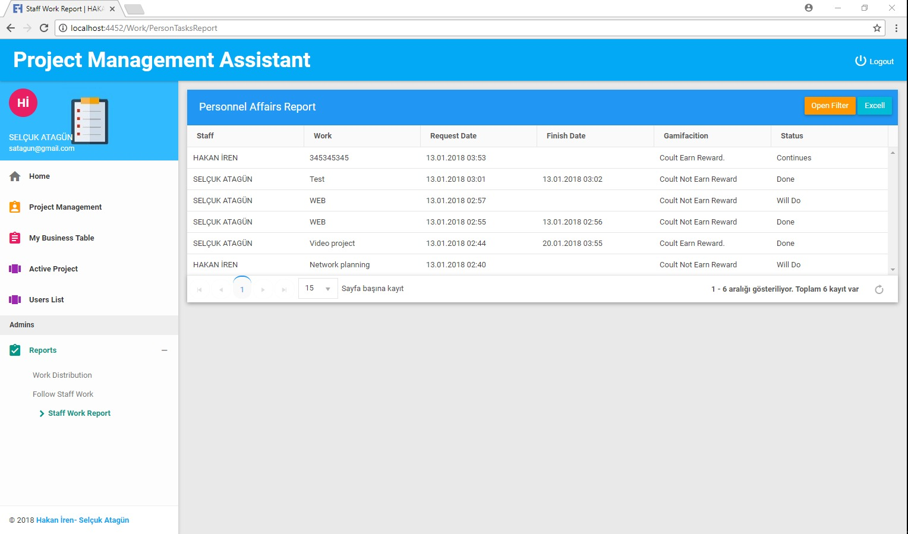
Work Report Page

